Slide 1







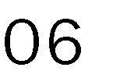



Slide 2











































Managing Director José Mannucci
Sales Manager VT
Sales Manager RT
Credit Manager
Finance Manager
Accounting Manager
Legal Serv Representative
Service Rep
Legal Officer
Service Rep
Service Rep

